Slide 1

http://winter.eecs.umich.edu/soarwiki
Jonathan Voigt
University of Michigan
Soar Workshop 25

Slide 2
What is a wiki?
From http://wikipedia.org/
    A wiki is a web application that allows users to add content, as on an internet forum, but also allows anyone to edit the content. Wiki also refers to the collaborative software used to create such a website.
Document history is saved
  (Similar to CVS and other systems like it)
Compatible with most browsers without installing additional software

Slide 3
How we are using the Soar Wiki
Developer documentation
  How to create Soar installers/packages
  How to add events
  How to add commands to Soar
Command line interface documentation
  Easy to keep up to date during the initial Soar 8.6 development cycles
  Soar manual documentation and on-line help generated automatically from content on the wiki

Slide 4

How to Update the Soar Wiki
Create an account and log in
Navigate to a page you would like to edit
Select the edit tab
Modify the wikitext
Save the page

Slide 5
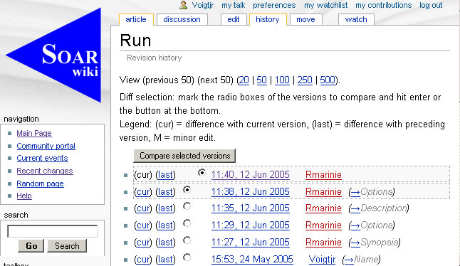
Document History
Revisions saved, much like CVS

Slide 6
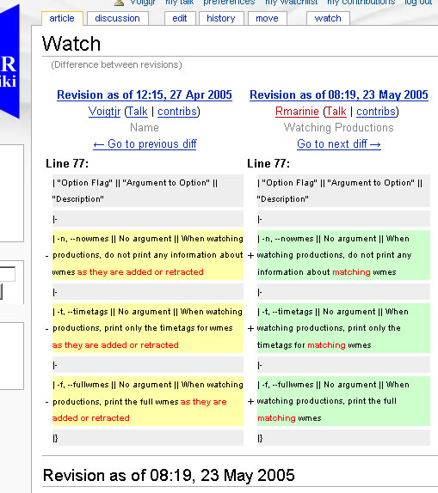
Document History

Slide 7
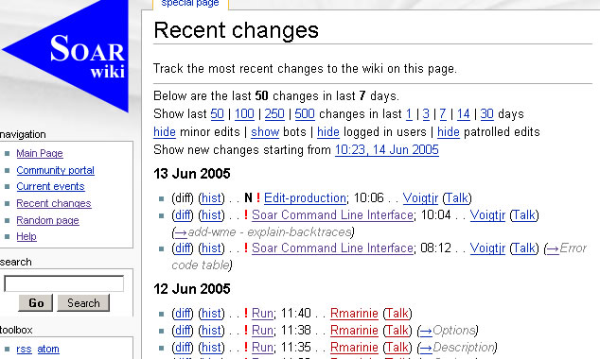
Wiki History
Changes to the wiki as a whole are summarized in a special page

Slide 8
Wikitext Example
= Name =
'''log''' - Record all user-interface input and output to a file.
= Synopsis =
log [–Ae] <u>filename</u>
log –a <u>string</u>
log [–cdoq]
= Options =
{| border="1" cellpadding="2"
| filename || Open filename and begin logging.
|-
| -c, --close, -o, --off, -d, --disable || Stop logging, close the file.
|-
| -a, --add string || Add the given string to the open log file.
|-
| -q, --query || Returns <i>open</i> if logging is active or <i>closed</i> if logging is not active.
|-
| -A, --append, -e, --existing || Opens existing log file named <u>filename</u> and logging is added at the end of the file.
|}

Slide 9
Wikitext Example
= Description =
The '''log''' command allows users to save all user-interface input and
output to a file. When
Soar is logging to a file, everything typed by the user and everything
printed by Soar is written to the file (in addition to the screen).
Invoke '''log''' with no arguments (or with '''-q''') to query the current logging status. Pass a filename to start logging to that file (relative to the command line interface's home directory (see the [[home]] command)). Use the '''close''' option to stop logging.
= Examples =
To initiate logging and place the record in foo.log:
log foo.log
To append log data to an existing foo.log file:
log -A foo.log
To terminate logging and close the open log file:
log -c

Slide 10
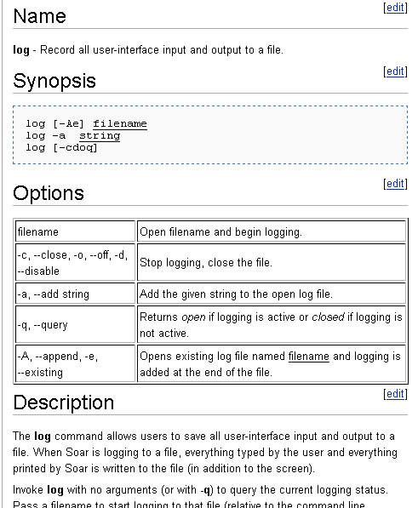

Slide 11
Nuggets
Coals
Anyone can contribute
Easy to keep up to date
Single source for command help
Great for developer documentation
  Word docs do not play well with CVS
Anyone can contribute
  Spam threat
Must learn wikitext

